Slide 1

Optimizing COVID-19 Vaccination Strategies: A Comprehensive Data Analysis Approach To Identify The Optimal Vaccine
BCSE351E
Foundations of Data Analytics
Digital Assignment – 1
Presented By:
21BLC1667 Meghavika Baidya
21BLC1668 Kulkarni Atharva g.

Slide 2

Problem Statement
The different facets of the existing COVID-19 vaccinations, such as their efficacy, cost, side effects, and availability, do not, however, have thorough and comparable data analysis. This project will utilizing a statistical study of COVID-19 vaccinations for the top 10 afflicted countries, and will offer insights on which vaccine is the best option for each nation based on a variety of variables.

Slide 3

OBJECTIVES/MOTIVATION:
To find a potent vaccine with respect to the cured rate, cost and side effects.
To explore the factors that influence the effectiveness and safety of COVID-19 vaccines across the top 10 afflicted countries and their populations.
To identify the gaps and limitations in the current data and methods for COVID-19 vaccine analysis.
To demonstrate the use of R as a powerful tool for data manipulation, visualization, and statistical modeling.

Slide 4
COVID-19 VACCINES ADMINISTERED IN THE TOP 10 AFFLICTED COUNTRIES:
S.No. | Country | Total Cases | Vaccines Implemented
1 | USA | 106,792,474 | Pfizer-BioNTech, Moderna, Johnson & Johnson
2 | India | 44,980,674 | Covishield (Oxford-AstraZeneca), Covaxin, Sputnik V
3 | France | 40,044,973 | AstraZeneca, Pfizer-BioNTech, Moderna, Johnson & Johnson
4 | Germany | 38,417,622 | AstraZeneca, Pfizer-BioNTech, Moderna, Johnson & Johnson
5 | Brazil | 37,511,921 | Coronavac, Covishield, Pfizer-BioNTech, Johnson & Johnson
6 | Japan | 33,803,572 | Pfizer-BioNTech, Moderna, Johnson & Johnson, AstraZeneca (Vaxzevria)
7 | South Korea | 31,415,280 | Covishield, Pfizer-BioNTech, Johnson & Johnson, Moderna
8 | Italy | 25,828,252 | Pfizer-BioNTech, Moderna, Johnson & Johnson, AstraZeneca (Vaxzevria)
9 | UK | 24,569,895 | Pfizer-BioNTech, Moderna, Johnson & Johnson, AstraZeneca (Vaxzevria)
10 | Russia | 22,898,376 | Sputnik V, EpiVacCorona,CoviVac

Slide 5
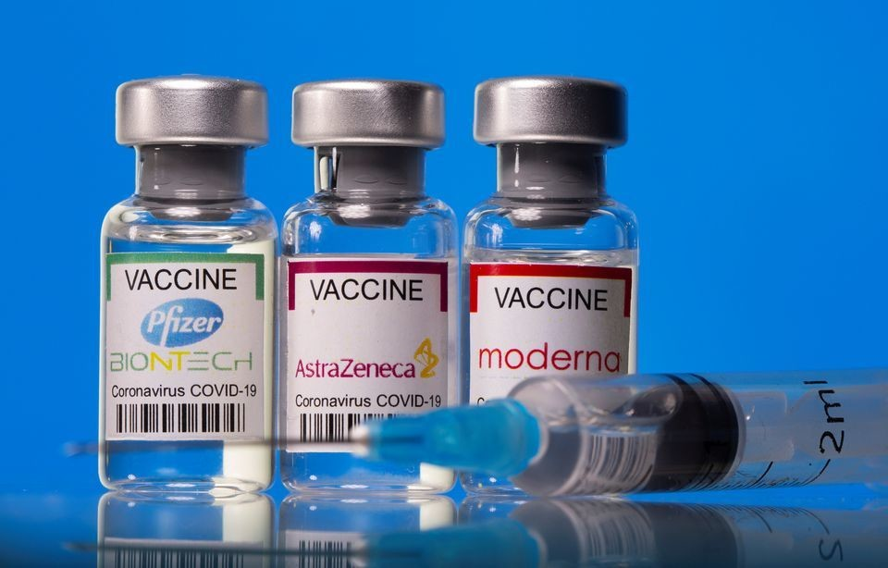
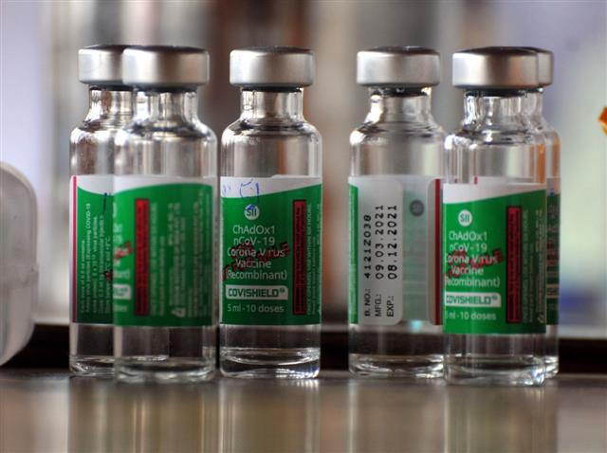
Pfizer, AstraZeneca and Moderna Vaccines
Covishield vaccine

Slide 6
Based on the previous information, the list of COVID-19 vaccines have been identified and narrowed down to the following vaccines:
Pfizer-BioNTech
Moderna
Johnson & Johnson
Covishield
Covaxin
AstraZeneca
Coronavac
EpiVacCorona
CoviVac
Sputnik V

Slide 7
LITERATURE REVIEW:
S.No. | Title/Publisher | Authors | Year of Publication | Methodology | Advantage | Drawback
1 | The Journey of a Lifetime — development of Pfizer’s COVID-19 vaccine | Chelsea R Thorn, Divya Sharma, Rodney Combs, Sonal Bhujbal, Jennifer Romine, Xiaolu Zheng, Khurram Sunasara, Advait Badkar | 2022 | mRNA vaccine development, strategic partnerships, rapid scaling and standardization | Speed, expertise leverage, cold-chain logistics | Scientific rigor, clinical trial nuances, credibility
2 | Covid-19: Moderna vaccine is nearly 95% effective, trial involving high risk and elderly people shows | Elisabeth Mahase | 2020 | Phase III trial methodology, diverse participant enrollment, randomized double-blind design | High efficacy, diverse participant pool, prevention of severe disease. | Lack of long-term data, limited transparency, incomplete evaluation.
3 | ANCA-associated vasculitis following Johnson and Johnson COVID-19 vaccine | Rukesh Yadav, Sangam Shah, Santosh Chhetri | 2022 | Case report methodology, AAV vaccination, data analysis | Study insights, real-world significance, expanded knowledge | Single case study, limited generalizability, need for further research
4 | Immunogenic and reactogenic efficacy of Covaxin and Covishield: a comparative review | Swarnali Das, Suvrendu Sankar Kar, Sovan Samanta, Jhimli Banerjee, Biplab Giri & Sandeep Kumar Dash | 2022 | Vaccine assessment, composition analysis, effectiveness evaluation | High efficacy, wide availability, global vaccination efforts | Limited long-term data, ongoing research needed, risk assessment
5 | Oxford–AstraZeneca COVID-19 vaccine efficacy | Maria Deloria Knoll and Chizoba Wonodi | 2020 | Randomized controlled trials, two-dose regimen, effectiveness evaluation | Strong immunogenicity, cross-protection, favorable safety profile | Lower efficacy in some cohorts, concerns about effectiveness, dosage evaluation
6 | Status of Humoral and Cellular Immune Responses within 12 Months following CoronaVac Vaccination against COVID-19 | Wei Zhao, Weixin Chen, Juan Li, Meng Chen, Qin Li, Min Lv, ShanShan Zhou, Shuang Bai, Yali Wang, Lichi Zhang, Peng Zhang, Jian Wang, Qun Zheng & Jiang Wu | 2022 | Prospective cohort design, immune response assessment, longitudinal analysis | Longitudinal study design, multi-dimensional assessment, rigorous statistical analysis | Lack of control group, reliance on self-reporting, absence of long-term follow-up data, potential confounding factors
7 | Retrospective Cohort Study of the Effectiveness of the Sputnik V and EpiVacCorona Vaccines against the SARS-CoV-2 Delta Variant in Moscow | Olga Matveeva and Alexander Ershov | 2022 | Retrospective cohort analysis, vaccine effectiveness, statistical analysis | Retrospective cohort analysis, comprehensive data analysis, statistical analysis | Retrospective study limitations, data reliability, potential biases, confounding variables, causal inference challenges

Slide 8
IN-DEPTH ANALYSIS

Slide 9
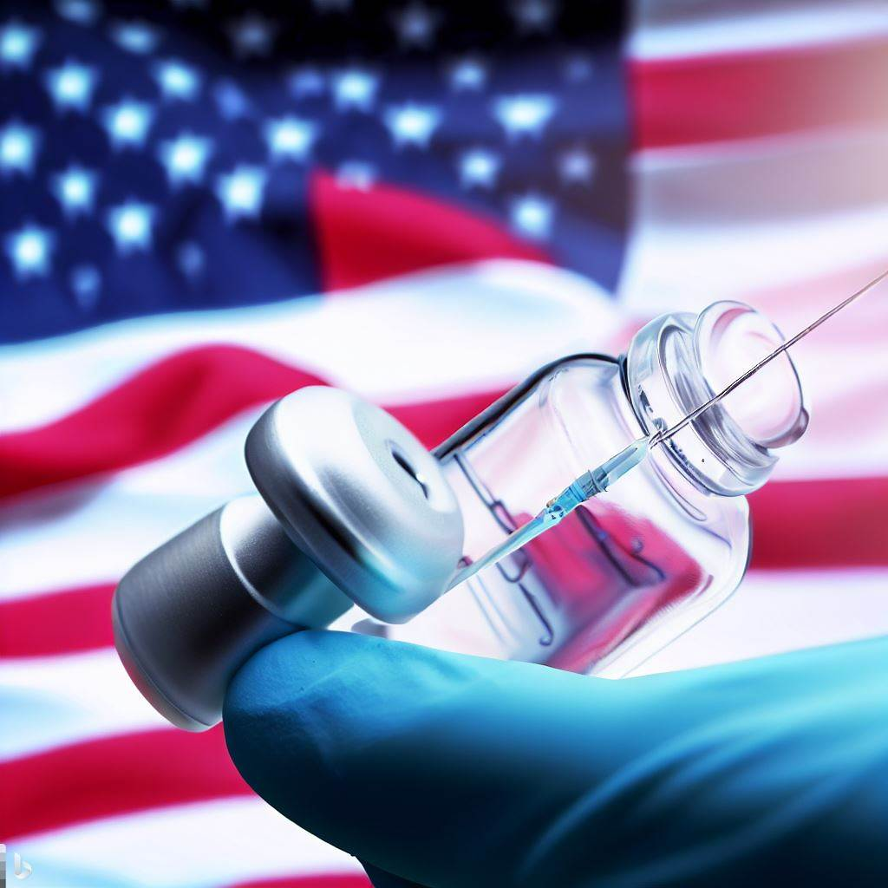
Literature Survey/Related Work
Index: 1
Title: The Journey of a Lifetime — development of Pfizer’s COVID-19 vaccine
Publisher: Science Direct
Author: Chelsea R Thorn, Divya Sharma, Rodney Combs, Sonal Bhujbal, Jennifer Romine, Xiaolu Zheng, Khurram Sunasara, Advait Badkar
Year of Publication: 2022
Methodology: Pfizer and BioNTech swiftly developed an mRNA-based vaccine in response to COVID-19. They created four vaccine candidates using three RNA platforms and secured partnerships for critical materials. Leveraging Pfizer's manufacturing technologies, the process was rapidly scaled up and standardized. Distribution logistics were tackled through rechargeable containers. The achievement was the result of collaboration, strategic decision-making, and a dedicated multidisciplinary team effort.

Slide 10
Literature Survey/Related Work
Advantage:
Speed and Efficiency: The mRNA-based approach enabled a rapid response, with emergency-use authorization achieved in a record-setting nine months.
Utilization of Existing Expertise: Pfizer leveraged prior expertise in DNA manufacturing and biologics to develop a platform process for the vaccine.
Cold-Chain Logistics: Developed rechargeable containers for maintaining ultracold temperatures, ensuring effective distribution and storage.
Drawback:
A potential drawback of the article is the limited scientific rigor in its examination of the Pfizer- BioNTech COVID-19 vaccine. The article may not sufficiently delve into the nuances of the clinical trial design, potential biases, or methodological limitations that could affect the interpretation of the vaccine's effectiveness and safety. The absence of critical appraisal and rigorous scientific scrutiny may lead to an incomplete understanding of the vaccine's overall efficacy and potential drawbacks. A more scientifically rigorous analysis would strengthen the credibility and reliability of the information presented.

Slide 11

Literature Survey/Related Work
Index: 2
Title: Covid-19: Moderna vaccine is nearly 95% effective, trial involving high risk and elderly people shows
Publisher: BMJ : British Medical Journal
Author: Elisabeth Mahase
Year of Publication: 2020
Methodology: In Moderna's phase III trial methodology, more than 30,000 participants were enrolled in the United States, including individuals from diverse backgrounds. The trial consisted of a vaccine group and a placebo group, with an interim analysis conducted on 95 cases of COVID-19. The trial's secondary endpoint focused on evaluating the vaccine's effectiveness in preventing severe disease. The study employed a randomized, double-blind design, where participants and investigators were unaware of who received the vaccine or the placebo. The trial's methodology aimed to assess the safety, efficacy, and impact on diverse populations, providing valuable data for regulatory authorities to evaluate the vaccine candidate.

Slide 12
Literature Survey/Related Work
Advantage:
High efficacy: The mRNA-1273 vaccine candidate demonstrated a 94.5% effectiveness rate in its Phase III trial, indicating its potential to provide robust protection against COVID-19.
Diverse participant pool: The trial included a substantial number of participants from diverse backgrounds, ensuring a more representative evaluation of the vaccine's safety and efficacy across different demographic groups.
Prevention of severe disease: The vaccine showed efficacy in preventing severe cases of COVID-19, which is crucial in reducing the burden on healthcare systems and preventing life-threatening complications.
Drawback:
One potential disadvantage is the lack of information on the long-term efficacy and safety of the mRNA-1273 vaccine. Without sufficient data on the duration of protection and potential side effects over an extended period, it is challenging to assess its overall effectiveness and make informed decisions about its widespread use. Additionally, the absence of published trial data limits scientific scrutiny and transparency, hindering a comprehensive evaluation of the study's methodology and results.

Slide 13

Literature Survey/Related Work
Index: 3
Title: ANCA-associated vasculitis following Johnson and Johnson COVID-19 vaccine
Publisher: Annals of Medicine and Surgeryjournal
Author: Rukesh Yadav, Sangam Shah, Santosh Chhetri
Year of Publication: 2022
Methodology: The article presents a case report methodology, examining a single case of AAV following COVID-19 vaccination. The study involved a 52-year-old woman who received the Johnson & Johnson vaccine. Medical records were reviewed, and a literature review was conducted to provide context. Data analysis focused on the temporal relationship between vaccination and AAV development. The findings were discussed, limitations acknowledged, and the need for further research emphasized.

Slide 14
Literature Survey/Related Work
Advantage:
Case Study Insights: This case study provides valuable insights into the occurrence of autoimmune adverse effects following COVID-19 vaccination, specifically AAV. It highlights the potential association between vaccines and autoimmune responses.
Real-World Significance: By examining a real-world case, this study emphasizes the importance of monitoring and investigating rare adverse events related to COVID-19 vaccines. It underscores the need for continued surveillance and assessment of vaccine safety.
Expanded Knowledge: The report of AAV following an adenovirus vector COVID-19 vaccine adds to our understanding of immune-related complications associated with different vaccine platforms. It contributes to the existing scientific literature and helps advance risk assessment and management in the field of vaccination.
Drawback:
The drawback of this research article is its reliance on a single case study, limiting the generalizability of the findings and requiring further research to confirm the potential association between the adenovirus vector COVID-19 vaccine and AAV. The lack of comprehensive patient medical history and limited details hinders drawing firm conclusions about the vaccine's specific role in this case. Larger studies are needed to establish the true incidence, prevalence, and risk factors of AAV following COVID-19 vaccination.

Slide 15

Literature Survey/Related Work
Index: 4
Title: Immunogenic and reactogenic efficacy of Covaxin and Covishield: a comparative review
Publisher: Springerlink: Immunologic Research
Author: Swarnali Das, Suvrendu Sankar Kar, Sovan Samanta, Jhimli Banerjee, Biplab Giri & Sandeep Kumar Dash
Year of Publication: 2022
Methodology: The article reviewed existing literature, clinical trials, and vaccine guidelines to assess the immunological efficacy of Covaxin and Covishield in India. The researchers analyzed the vaccines' composition, mode of action, recommended dosages, and storage requirements. They evaluated the humoral immune response, including antibody production and virus neutralization, as well as the vaccines' impact on T cell activation and cytokine release. The study also considered real-world data on infection rates, hospitalization, and mortality to determine the vaccines' effectiveness against different SARS-CoV-2 variants in the Indian population.

Slide 16
Literature Survey/Related Work
Advantage:
Proven Efficacy Against COVID-19: Covishield and Covaxin have demonstrated high efficacy in preventing severe illness, hospitalization, and death.
Wide Availability and Accessibility: Both vaccines are widely available, making them accessible to diverse populations and contributing to global vaccination efforts.
Drawback:
One drawback highlighted in the article is the limited data available on the long-term effects of Covishield and Covaxin. While these vaccines have shown promising results in terms of immediate protection against COVID-19, there is still a need for ongoing research to assess their long-term safety and effectiveness. Gathering comprehensive data on potential side effects and long-term immunity will be essential for providing individuals with a complete understanding of the vaccines' overall benefits and risks.

Slide 17
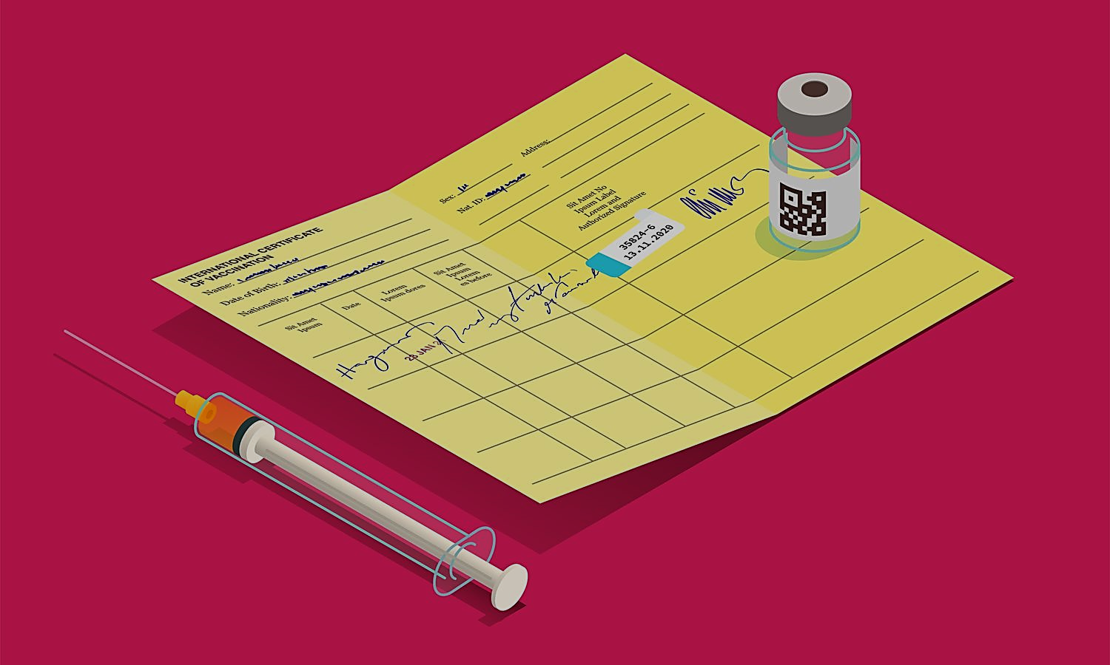
Literature Survey/Related Work
Index: 5
Title: Oxford–AstraZeneca COVID-19 vaccine efficacy
Publisher: The Lancet
Author: Maria Deloria Knoll and Chizoba Wonodi
Year of Publication: 2020
Methodology: The article analyzed data from four randomized, controlled trials conducted in the UK, South Africa, and Brazil to evaluate the safety and efficacy of the Oxford-AstraZeneca COVID-19 vaccine, ChAdOx1 nCoV-19 (AZD1222). Participants, aged 18 years and older, were randomly assigned to receive either the vaccine or a control (MenACWY or saline). The vaccine was administered as a two-dose regimen, with a 28-day interval between doses. The trials assessed the occurrence of COVID-19 cases and evaluated the effectiveness of the vaccine in preventing severe illness and hospitalization.

Slide 18
Literature Survey/Related Work
Advantage:
Strong Immunogenicity: The Oxford-AstraZeneca vaccine elicits a robust immune response, stimulating the production of neutralizing antibodies and T-cell responses against the SARS-CoV-2 virus.
Cross-Protection Against Variants: The vaccine provides effective protection against emerging variants of the virus, reducing the risk of breakthrough infections and contributing to the control of the pandemic.
Favorable Safety Profile: The vaccine has shown a favorable safety profile, with mild and transient side effects and rare serious adverse events, providing confidence in its overall safety for widespread use.
Drawback:
Lower Efficacy in Some Cohorts: The article highlights that the Oxford-AstraZeneca vaccine demonstrated lower efficacy in certain cohorts, such as those who received a standard-dose regimen. This discrepancy in efficacy raises concerns about the vaccine's effectiveness in specific population groups, necessitating further evaluation and potential adjustments to dosage strategies.

Slide 19

Literature Survey/Related Work
Index: 6
Title: Status of Humoral and Cellular Immune Responses within 12 Months following CoronaVac Vaccination against COVID-19
Publisher: ASM Journals
Author: Wei Zhao, Weixin Chen, Juan Li, Meng Chen, Qin Li, Min Lv, ShanShan Zhou, Shuang Bai, Yali Wang, Lichi Zhang, Peng Zhang, Jian Wang, Qun Zheng & Jiang Wu
Year of Publication: 2022
Methodology: This study utilized a prospective cohort design to investigate the immune response after CoronaVac COVID-19 vaccination. A total of 145 individuals aged 18-59 received two doses of the vaccine. Blood samples were collected at baseline and at 1, 3, 6, and 12 months after the second dose. Antibody levels were measured using ELISA, memory T cells were assessed via flow cytometry, and cytokine responses were evaluated. Changes in antibody titers and memory T cells over time were analyzed using statistical tests. The study adhered to ethical guidelines and obtained informed consent from all participants.

Slide 20
Literature Survey/Related Work
Advantage:
Longitudinal Study Design: Prospective cohort design allowed for tracking changes in immune response over time after vaccination.
Multi-Dimensional Assessment: Multiple assessment methods provided a comprehensive understanding of the immune response, including antibody levels, memory T cells, and cytokine responses.
Rigorous Statistical Analysis: Statistical tests identified significant trends in antibody titers and memory T cells, enhancing the study's scientific validity.
Drawback:
The drawback of this article is the potential for selection bias due to the study's recruitment process, which relied on voluntary participation. This could introduce a bias towards individuals who are more likely to have positive experiences or outcomes after vaccination. Another limitation is the lack of a control group, which makes it challenging to establish a direct comparison or determine the causal relationship between the vaccine and the reported effects. Additionally, the study relies on self-reporting by participants, which can introduce subjective biases and inaccuracies. The absence of long-term follow-up data is another drawback, as it prevents a comprehensive understanding of the duration and persistence of the reported effects. Finally, the article does not address potential confounding factors, such as the participants' pre-existing health conditions or concurrent medication use, which could influence the outcomes observed.

Slide 21

Literature Survey/Related Work
Index: 7
Title: Retrospective Cohort Study of the Effectiveness of the Sputnik V and EpiVacCorona Vaccines against the SARS-CoV-2 Delta Variant in Moscow
Publisher: MDPI
Author: Olga Matveeva and Alexander Ershov
Year of Publication: 2022
Methodology: The study used a retrospective cohort analysis to evaluate the effectiveness of Sputnik V and EpiVacCorona vaccines against the Delta variant. Data from the Moscow Health Department was analyzed, categorizing COVID-19 cases by age, vaccination status, vaccine type, dose count, and severity of illness or death. Vaccine effectiveness was calculated using published algorithms and chi-square tests. Statistical analysis was conducted to compare vaccine effectiveness in different age groups.

Slide 22
Literature Survey/Related Work
Advantage:
Retrospective Cohort Analysis: The study uses real-world data to assess the effectiveness of Sputnik V and EpiVacCorona vaccines against the Delta variant.
Comprehensive Data Analysis: Multiple variables such as age, vaccination status, and severity of illness are considered, providing a comprehensive understanding of vaccine effectiveness.
Statistical Analysis: Rigorous statistical techniques enhance the reliability of the study's findings, supporting conclusions about the vaccines' effectiveness against the Delta variant.
Drawback:
One potential limitation of this study is the retrospective nature of the analysis, which relies on previously recorded data. Retrospective studies are prone to inherent limitations, including the reliance on accurate and complete data, potential biases in data collection, and the inability to control for confounding variables. These factors can introduce uncertainties and make it challenging to establish a causal relationship between the variables of interest. Therefore, caution should be exercised when interpreting the findings and generalizing them to broader populations.

Slide 23
OBSERVATION TABLE:
Index | Vaccine | Doses | Price/Dose (in Rs) | Total Price (in Rs) | Efficacy (%) | Country of Origin
1 | Pfizer-BioNTech | 2 | 1600 | 3200 | 95 | USA, Germany
2 | Moderna | 2 | 2715 | 5430 | 94.1 | USA
3 | Johnson & Johnson | 1 | 735 | 735 | 66.3 | USA
4 | Covishield | 2 | 208 | 416 | 70.4 | India, UK
5 | AstraZeneca | 2 | 410 | 820 | 70.4 | UK
6 | Coronavac (Sinovac) | 2 | 1020 | 2040 | 50.7 | China
7 | EpiVacCorona | 2 | 905 | 1810 | _____ | Russia
8 | CoviVac | 2 | 210 | 420 | _____ | Russia
9 | Sputnik V | 2 | 995 | 1990 | 91.6 | Russia
10 | Covaxin | 2 | 206 | 412 | 78 | India

Slide 26
Side Effects

Slide 27
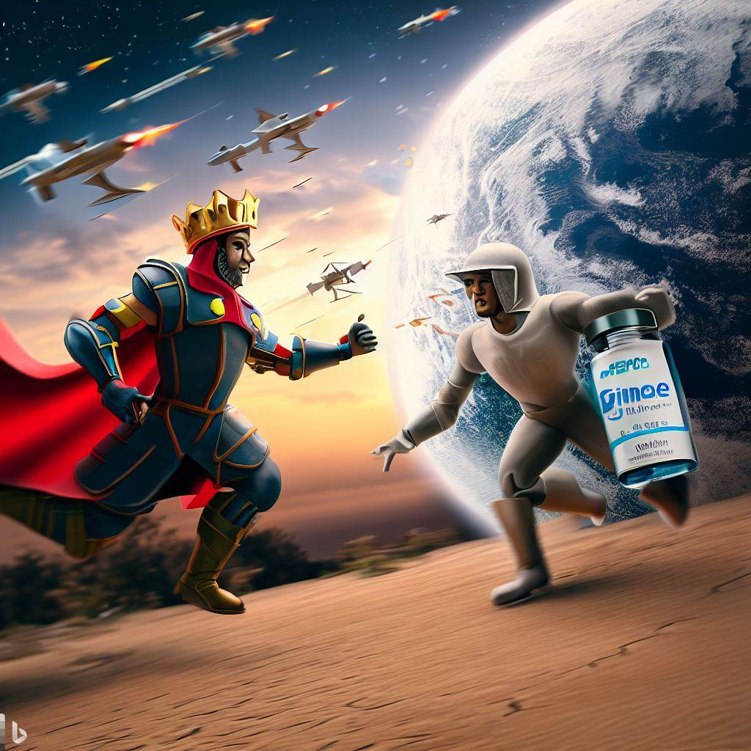
Pfizer-BioNTech
Injection Site Reactions: It is common to experience pain, redness, or swelling at the injection site. This reaction usually subsides within a few days and is considered a normal response to the vaccine.
Fatigue: Some individuals have reported feeling tired or experiencing fatigue after receiving the Pfizer vaccine. This is typically a temporary side effect and should resolve within a few days.
Headache: Headaches have been reported as a side effect of the Pfizer vaccine. While most headaches are mild and short-lived, some individuals may experience more intense or prolonged headaches.
Muscle Pain: Muscle pain or myalgia has been observed in some individuals who received the Pfizer vaccine. This discomfort is generally mild and tends to resolve within a few days.

Slide 28

Moderna
Lymphadenopathy: Lymphadenopathy is the medical term for lymph node swelling. Some people who received the Moderna vaccination have complained of transient lymph node swelling, especially in the arm where the vaccine was given. Usually, this adverse effect goes away on its own in a few days.
Vomiting and Nausea: Although it is rare, some people have mentioned feeling sick after receiving the Moderna vaccine. Typically, these symptoms are minor and go away on their own.
Allergic Reactions: Although they are uncommon, allergic reactions to vaccines, including the Moderna vaccine, are possible. Hives, itchiness, breathing issues, and swelling of the face, lips, tongue, or throat are possible side effects for some people. If an allergic response happens, you should get medical help right away.

Slide 29

Johnson & Johnson
Blood Clots: In rare cases, individuals who received the Johnson & Johnson vaccine have developed blood clots, particularly in combination with low levels of platelets. These blood clotting events are extremely rare but have been observed primarily in women under the age of 50. It is important to be aware of the signs and symptoms of blood clots, such as severe headache, abdominal pain, leg pain, or shortness of breath, and seek immediate medical attention if any such symptoms occur.
Fatigue and Body Aches: Some individuals have reported experiencing fatigue and body aches after receiving the Johnson & Johnson vaccine. These symptoms are typically mild and temporary, resolving within a few days.
Injection Site Reactions: Similar to other vaccines, pain, redness, or swelling at the injection site can occur with the Johnson & Johnson vaccine. These local reactions are usually mild and resolve on their own within a few days

Slide 30

Covishield
Injection Site Reactions: It is common to experience pain, redness, or swelling at the injection site with Covishield. This reaction is typically mild and temporary, resolving within a few days.
Flu-like Symptoms: Some individuals may experience flu-like symptoms after receiving the Covishield vaccine. These symptoms can include fever, headache, fatigue, muscle or joint pain, and general malaise. Most people find these symptoms to be mild and self-limiting.
Allergic Reactions: While rare, allergic reactions to the Covishield vaccine can occur. Symptoms may include hives, itching, swelling of the face or throat, difficulty breathing, or a rapid heartbeat. If any signs of an allergic reaction are noticed, immediate medical attention should be sought.

Slide 31

Covaxin
Injection Site Reactions: Pain, redness, or swelling at the injection site are common side effects of Covaxin. These reactions are generally mild and temporary, resolving within a few days.
Fatigue and Malaise: Some individuals have reported experiencing fatigue, tiredness, or a general feeling of malaise after receiving the Covaxin vaccine. These symptoms are usually mild and transient, improving within a short period.
Headache and Body Aches: Headaches and body aches have been reported as potential side effects of Covaxin. These symptoms are typically mild and short-lived, resolving on their own without complications.

Slide 32

AstraZeneca
Thrombosis with Thrombocytopenia Syndrome (TTS): A rare but serious side effect that has been associated with the AstraZeneca vaccine is thrombosis with thrombocytopenia syndrome (TTS). It involves the formation of blood clots in combination with low platelet levels. While extremely rare, cases of TTS have been reported, primarily in women under the age of 50. Immediate medical attention should be sought if symptoms such as severe headache, abdominal pain, leg pain, or shortness of breath occur.
Gastrointestinal Symptoms: Some individuals who received the AstraZeneca vaccine have reported experiencing gastrointestinal symptoms. These can include nausea, vomiting, diarrhea, or abdominal pain. While typically mild and temporary, it is important to monitor and consult a healthcare professional if symptoms persist or worsen.
Flu-like Symptoms: As with many vaccines, flu-like symptoms may occur after receiving the AstraZeneca vaccine. These symptoms can include fever, fatigue, muscle aches, headache, and general malaise. Most individuals find these symptoms to be mild and self-resolving within a few days.

Slide 33

Coronavac
Dizziness and Syncope: In rare cases, individuals who have received the CoronaVac vaccine have reported experiencing dizziness or episodes of fainting. While infrequent, these instances should be treated seriously. If feeling lightheaded or dizzy after vaccination, it is important to sit or lie down and seek immediate medical attention if fainting occurs.
Pruritus at Injection Site: Itching at the injection site has been observed as a possible side effect of the CoronaVac vaccine. Although generally mild and temporary, some individuals may experience localized itching or irritation in the area where the vaccine was administered.
Fatigue and Asthenia: Fatigue and a general sense of weakness have been documented as potential side effects of the CoronaVac vaccine. These symptoms are typically mild and resolve within a few days.

Slide 34
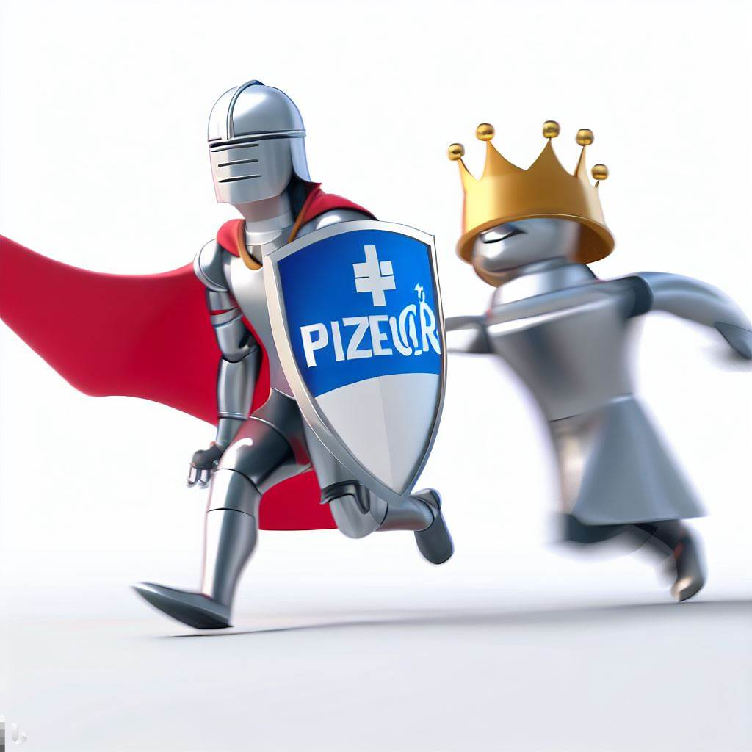
CoviVac
Fatigue and Weakness: Fatigue and a general sense of weakness have been reported by some individuals after receiving the Covivac vaccine. These symptoms are typically mild and temporary, with improvement within a few days.
Gastrointestinal Disturbances: Some individuals who have received the Covivac vaccine have reported experiencing diarrhea and abdominal discomfort. These gastrointestinal symptoms are generally mild and short-lived, resolving within a brief period.
Lymph Node Swelling: Lymphadenopathy, characterized by the enlargement of lymph nodes, has been observed as a possible side effect of the Covivac vaccine. Swollen or tender lymph nodes near the injection site can occur, but this reaction is usually temporary and self-resolving.

Slide 35

Sputnik V
Elevated Heart Rate: Some individuals who have received the Sputnik V vaccine have reported experiencing an elevated heart rate or palpitations. While this side effect is rare, it should be monitored and reported to healthcare professionals if it persists or becomes severe.
Allergic Skin Reactions: Allergic skin reactions, such as rashes or itching, have been reported as potential side effects of the Sputnik V vaccine. These reactions are typically mild and localized, resolving without complications in most cases.
Blood Clotting Disorders: In rare instances, the Sputnik V vaccine has been associated with blood clotting disorders, including deep vein thrombosis (DVT) or thrombocytopenia. Individuals who experience severe or persistent headaches, chest pain, leg swelling, or shortness of breath after vaccination should seek immediate medical attention.

Slide 36
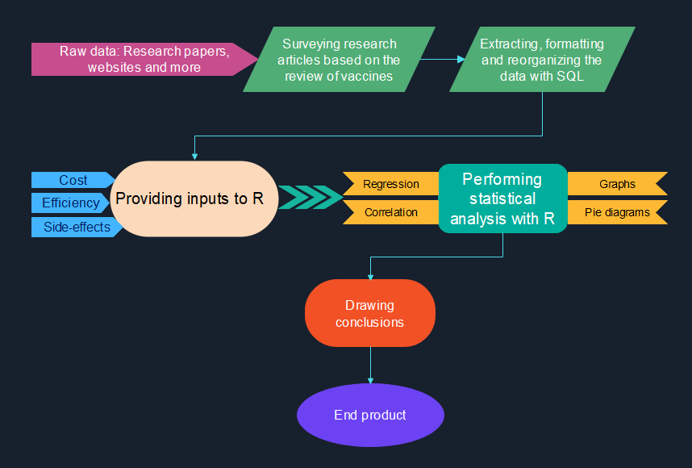
Block Diagram/Methodology

Slide 37

Research Gap
There is a lack of comprehensive and comparative data analysis on the various aspects of the available COVID-19 vaccines, such as their efficacy, cost, side effects and availability, for the top 10 affected countries.
Most of the existing studies focus on individual vaccines or countries, and do not provide a global perspective or a data-driven approach to evaluate and compare the vaccines.
Moreover, some of the studies are outdated or biased, and do not account for the latest developments and challenges of the pandemic, such as the emergence of new variants and the unequal distribution of vaccines.
This gap in knowledge hinders the optimal allocation and utilization of COVID-19 vaccines for the top 10 affected countries, and limits the potential benefits and impacts of the vaccines for controlling the pandemic and saving lives.
This project aims to fill this gap by using R and SQL to perform a statistical analysis of COVID-19 vaccines for the top 10 affected countries and provide insights on which vaccine is the best choice for each country based on their cost, side-effects and cure rate.

Slide 38
Conclusion:
With respect to price and affordability, the most potential vaccine is Covaxin, followed by Covishield.
With respect to efficacy, the most potential vaccine is Pfizer-BioNTech
Based on the provided information, the most suitable vaccine considering both optimal cost and higher efficacy rate would be the Sputnik-V vaccine. It has an efficacy rate of 91.6% and a total price of Rs. 1990, which is relatively high compared to some other vaccines.
Thus, an in-depth statistical analysis will be made using R to arrive at further accurate results.

Slide 39
References (Links, Books, Journals, Conference Papers)
https://www.who.int/publications/m/item/covid-19-vaccines-knowledge-gaps-and-research-priorities---who-ad-hoc-consultation
https://www.nature.com/articles/s41579-022-00837-3
https://news.un.org/en/story/2022/03/1114762
https://www.gov.uk/government/news/new-study-into-covid-19-vaccine-dose-interval-for-pregnant-women
https://pubmed.ncbi.nlm.nih.gov/34707602/
https://www.sciencedirect.com/science/article/pii/S0958166922001379
https://www.proquest.com/openview/f23612d9e0218b4d0ee67dcdb5c57884/1?pq-origsite=gscholar&cbl=2043523
https://doi.org/10.1016/S0140-6736(20)32623-4
https://www.mdpi.com/2076-393X/10/7/984
https://www.indiatoday.in/coronavirus-outbreak/vaccine-updates/story/here-is-what-one-dose-of-various-covid-19-vaccines-will-cost-in-india-1758527-2021-01-13
https://www.precisionvaccinations.com/vaccines/epivaccorona-vaccine#:~:text=EpiVacCorona%20Price&text=According%20to%20TASS%2C%20the%20maximum,842%20rubles%20(US%2411).
https://chaohanoi.com/2021/03/03/covivac-vaccine-to-cost-60000-vnd-per-dose/

Slide 40


